Slide 1


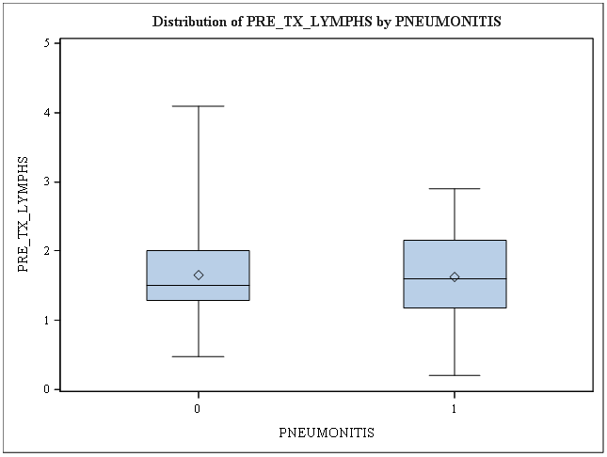
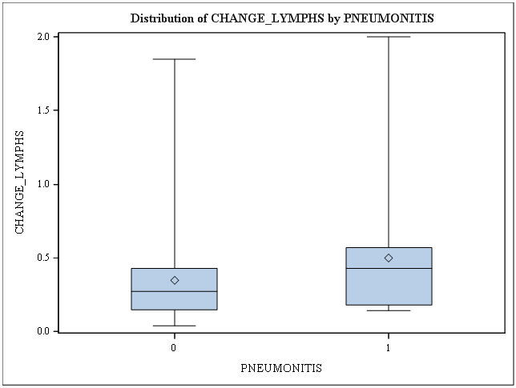
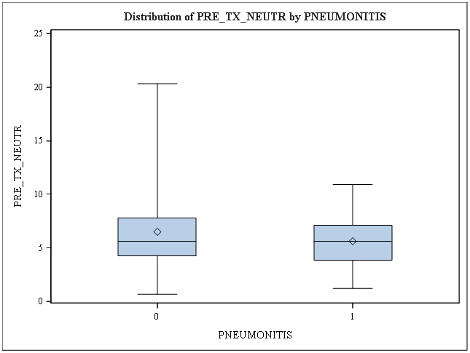
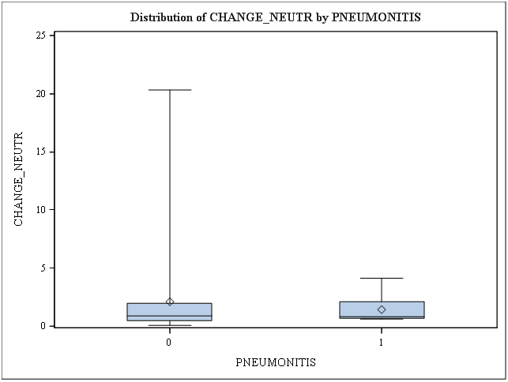
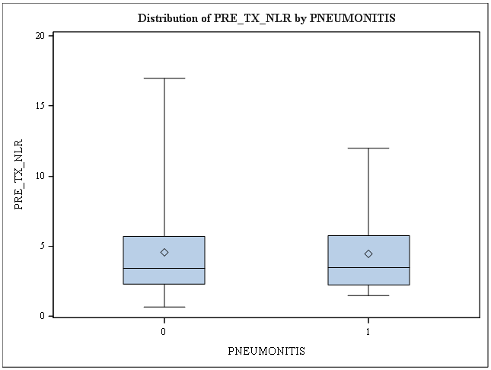
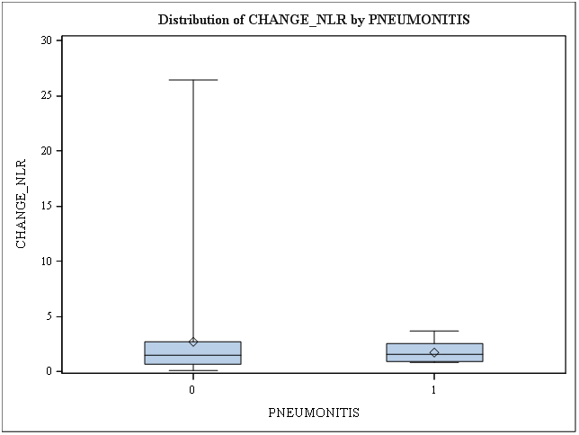
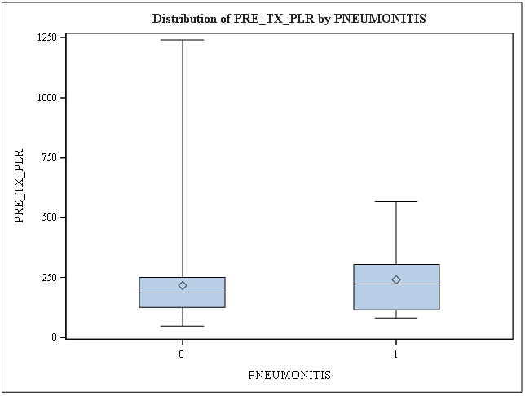
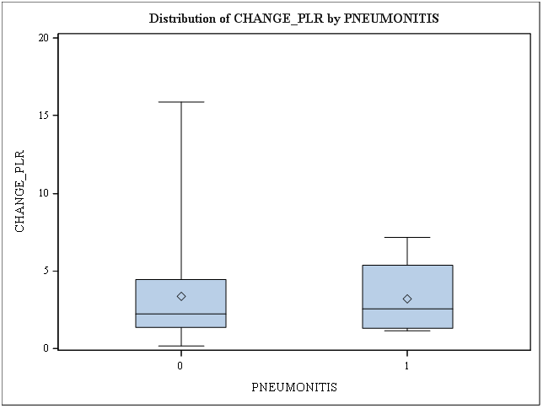
Immune Parameters as Predictors of Pneumonitis and Survival in Locally Advanced Non-Small Cell Lung Cancer Treated with Chemoradiation
Quoc-Anh Ho BS, Lihong Qi PhD, Shyam S. Rao MD PhD, Megan E. Daly MD
Department of Radiation Oncology, University of California Davis Comprehensive Cancer Center, Sacramento, CA.
INTRODUCTION
MATERIALS AND METHODS
RESULTS
CONCLUSIONS
Immune parameters including platelet lymphocyte ratio (PLR) and neutrophil lymphocyte ratio (NLR) have been associated with survival in a variety of cancers and may serve as markers of systemic inflammation.
Prior studies have identified PLR and NLR as predictors of overall survival (OS) and toxicity, including radiation pneumonitis (RP), following stereotactic radiotherapy and surgery for early stage lung cancer, but this association is less well-studied for locally advanced non-small cell lung cancer (LA-NSCLC) [1, 2].
Radiation pneumonitis is a potential dose-dependent adverse effect of radiation therapy that lowers quality of life, increases hospitalizations, and can lead to complications that worsens prognosis. It is often mild, but may cause acute (four to twelve weeks) or fibrotic (late, six to twelve months, refractory to treatment) manifestations [3, 4]:
∙ Symptoms: nonproductive cough, dyspnea on exertion, fever, chest pain, malaise, weight loss
∙ Signs: crackles, pleural rub, dullness to percussion, stable pleural effusion, tachypnea, cyanosis, pulmonary hypertension (advanced)
The records of 106 consecutive LA-NSCLC patients treated with definitive CRT from 2004-2015 were reviewed. Pre-treatment complete blood count (CBC) with differential was available for 87 patients who form the study population. 63 patients also had a post-treatment CBC within 3 weeks of completing CRT. Pre- and post- treatment immune parameters were documented. RP was scored according to CTCAE v 4.0 [5].
The association between each parameter and development of grade 2+ RP was assessed as a continuous variable with logistic regression, and association with OS was assessed as a continuous variable with a Cox proportional hazards model.
At a median follow-up of 24.8 months for living patients, 2 and 3-year actuarial estimates of OS were 51% and 38%, respectively, for the entire cohort. Twelve patients (14%) developed grade 2+ RP. No pre-treatment immune parameter was significantly predictive of RP development. Among the evaluated pre-treatment immune parameters, only elevated ANC trended toward an association with improved OS (p=0.08). No significant association between pre-treatment ANC, ALC, albumin, PLR, or NLR and OS was identified. Change from pre- to post-treatment value for all evaluated parameters was similarly not predictive of OS or development of RP significantly.
In contrast to early stage NSCLC studies, we identified no statistically significant association between pre-treatment immune parameters and OS or RP in a cohort of LA-NSCLC patients treated with CRT. We identified a trend toward improved OS in patients with an elevated pre-treatment ANC, contrasting with previous studies associating elevated ANC with OS decrements for early stage NSCLC. Our data suggest application of predictive models based on immune profile derived from early stage early stage patients to LA-NSCLC may be premature, and interrogation of larger datasets is warranted to further elucidate associations between immune profile, toxicity, and OS in this population. Subsequently, this will allow physicians to further stratify patients and identify those who are more likely able to tolerate radiation therapy safely.
Grade | Signs, Symptoms, Interventions
1 | Asymptomatic; clinical or diagnostic observations only; intervention not indicated
2 | Symptomatic; medial intervention indicated; limited instrumental ADL
3 | Severe symptoms; limiting self-care ADL; oxygen indicated
4 | Life-threatening respiratory compromise; urgent intervention indicated (eg, tracheostomy or intubation)
5 | Death
REFERENCES
[1] Shaverdian, Narek, et al. "Pretreatment Immune Parameters Predict for Overall Survival and Toxicity in Early-Stage Non–Small-Cell Lung Cancer Patients Treated With Stereotactic Body Radiation Therapy." Clinical lung cancer 17.1 (2016): 39-46.
[2] Kobayashi, Naohiro, et al. "Preoperative lymphocyte count is an independent prognostic factor in node-negative non-small cell lung cancer." Lung cancer 75.2 (2012): 223-227.
[3] Abratt, Raymond P., et al. "Pulmonary complications of radiation therapy." Clinics in chest medicine 25.1 (2004): 167-177.
[4] Gross, Nicholas J. "Pulmonary effects of radiation therapy." Annals of internal medicine 86.1 (1977): 81-92.
[5] National Cancer Institute. Common Terminology Criteria for Adverse Events v.3.0and v.4.0 (CTCAE).
OBJECTIVES
To assess the following pre-treatment, and change in value from pre- to post-treatment immune parameters:
∙ Absolute Lymphocyte Count (ALC)
∙ Absolute Neutrophil Count (ANC)
∙ Neutrophil-to-Lymphocyte Ratio (NLR)
∙ Platelet-to-Lymphocyte Ratio (PLR)
In relation to the following outcomes:
∙ Overall Survival
∙ Radiation Pneumonitis (Grade 2 or higher)
ACKNOWLEDGEMENTS AND CONTACTS
For questions, please contact Quoc-Anh Ho at quoho@ucdavis.edu.

